Slide 1

Detecting Fraudulent Credit Card Transactions
Chika Umeadi
9/26/2020
Cumeadi@gmail.com

Slide 2
Outline
Executive Summary
Methodology
Problem
Data
Hypothesis
Analysis
Results
Conclusion
Next Steps

Slide 3

The United States accounted for $9.47 billion in fraud losses in 2018. Even though cardholders in the U.S. generated only 21.54% of $40.582 trillion in global card volume in 2018, U.S. companies incurred 33.99% of total card fraud losses worldwide. U.S. fraud losses amounted to 10.83¢ for every $100 in cardholder spending.

Slide 4
Executive Summary
Credit card fraud is a major issue for customers but even more detrimental for companies in the credit ecosystem. There’s an opportunity to leverage data around transactions to help predict whether a credit card transaction is fraudulent or not.
After further analysis, due to the rare occurrence of fraudulent transactions, we recommend to business:
We identify the true cost of fraudulent transactions
If a transaction looks like it might be a fraudulent transaction, we should verify with the customer to validate if it was indeed them who facilitated the transactions.
If we do this, we can decrease the number of fraudulent transactions by adding validation to questionable transactions.

Slide 5
Methodology
Leveraging a Kaggle dataset on European transactions, I performed exploratory data analysis, linear regression models, and a k- means clustering model to identify any major insights about the data.
Dataset Here
EDA Notebook Here
Model Notebook Here

Slide 6
Problem
U.S. fraud losses amounted to 10.83¢ for every $100 in cardholder spending. How do we know which transaction is fraudulent? Are there any major indicators for what might be a fraudulent transaction?

Slide 7
Data
The datasets contains transactions made by credit cards in September 2013 by European cardholders.
The dataset presents transactions that occurred in two days.
It contains only numerical input variables which are the result of a PCA transformation. Unfortunately, due to confidentiality issues, Kaggle did provide the original features and more background information about the data. Features V1, V2, … V28 are the principal components obtained with PCA, the only features which have not been transformed with PCA are 'Time' and 'Amount'. Feature 'Time' contains the seconds elapsed between each transaction and the first transaction in the dataset.

Slide 8

Hypothesis
By analyzing the dataset, we’ll find a relationship of features of the transaction that is highly corelated with transactions that have been flagged as fraudulent.

Slide 9
Analysis
We have 492 frauds out of 284,807 transactions. The dataset is highly unbalanced, the positive class (frauds) account for 0.172% of all transactions.

Slide 10
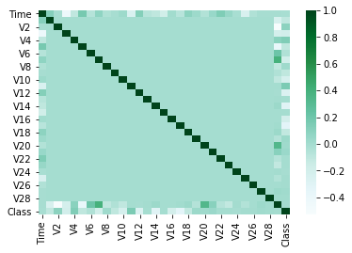
Analysis
Low correlation across features. There are some areas of interest around v6, v7, and v20
Data set, on an individual feature level may not be as predicative as needed to build a linear regression model right out of the box.

Slide 11
Results
Multivariate linear regression score : .52169
K folds best Cross-validated scores: [0.35810924 0.59194815 0.52405638 0.39852009 0.70735054 0.41947473 0.37571762 0.4910792 0.36022886] K= 9
KNN Accuracy Score : .998188
2 Main Takeaways
Linear regression ended up doing better than we thought it would based on EDA. Using all features available, our 1st model will guess the correct transaction class 52% of the time
KNN may look super accurate but its reflecting the imbalance in the data more than its telling us anything. If we wanted to learn more, we’d have to do more work on down/ up sampling the minority represented data.

Slide 12
Conclusion
There’s still some more data exploration needed. I’d like to get some other models in place and try a little bit more on over/under sampling data.
Out of the box linear regression outcome can be beneficial for business at its current performance.
While there were no features that stood out as highly correlated with a fraudulent transaction, collectively, they were enough to give us a about a 50% chance.
With more time, I’d also explore some more features by segmenting features based on class.

Slide 13
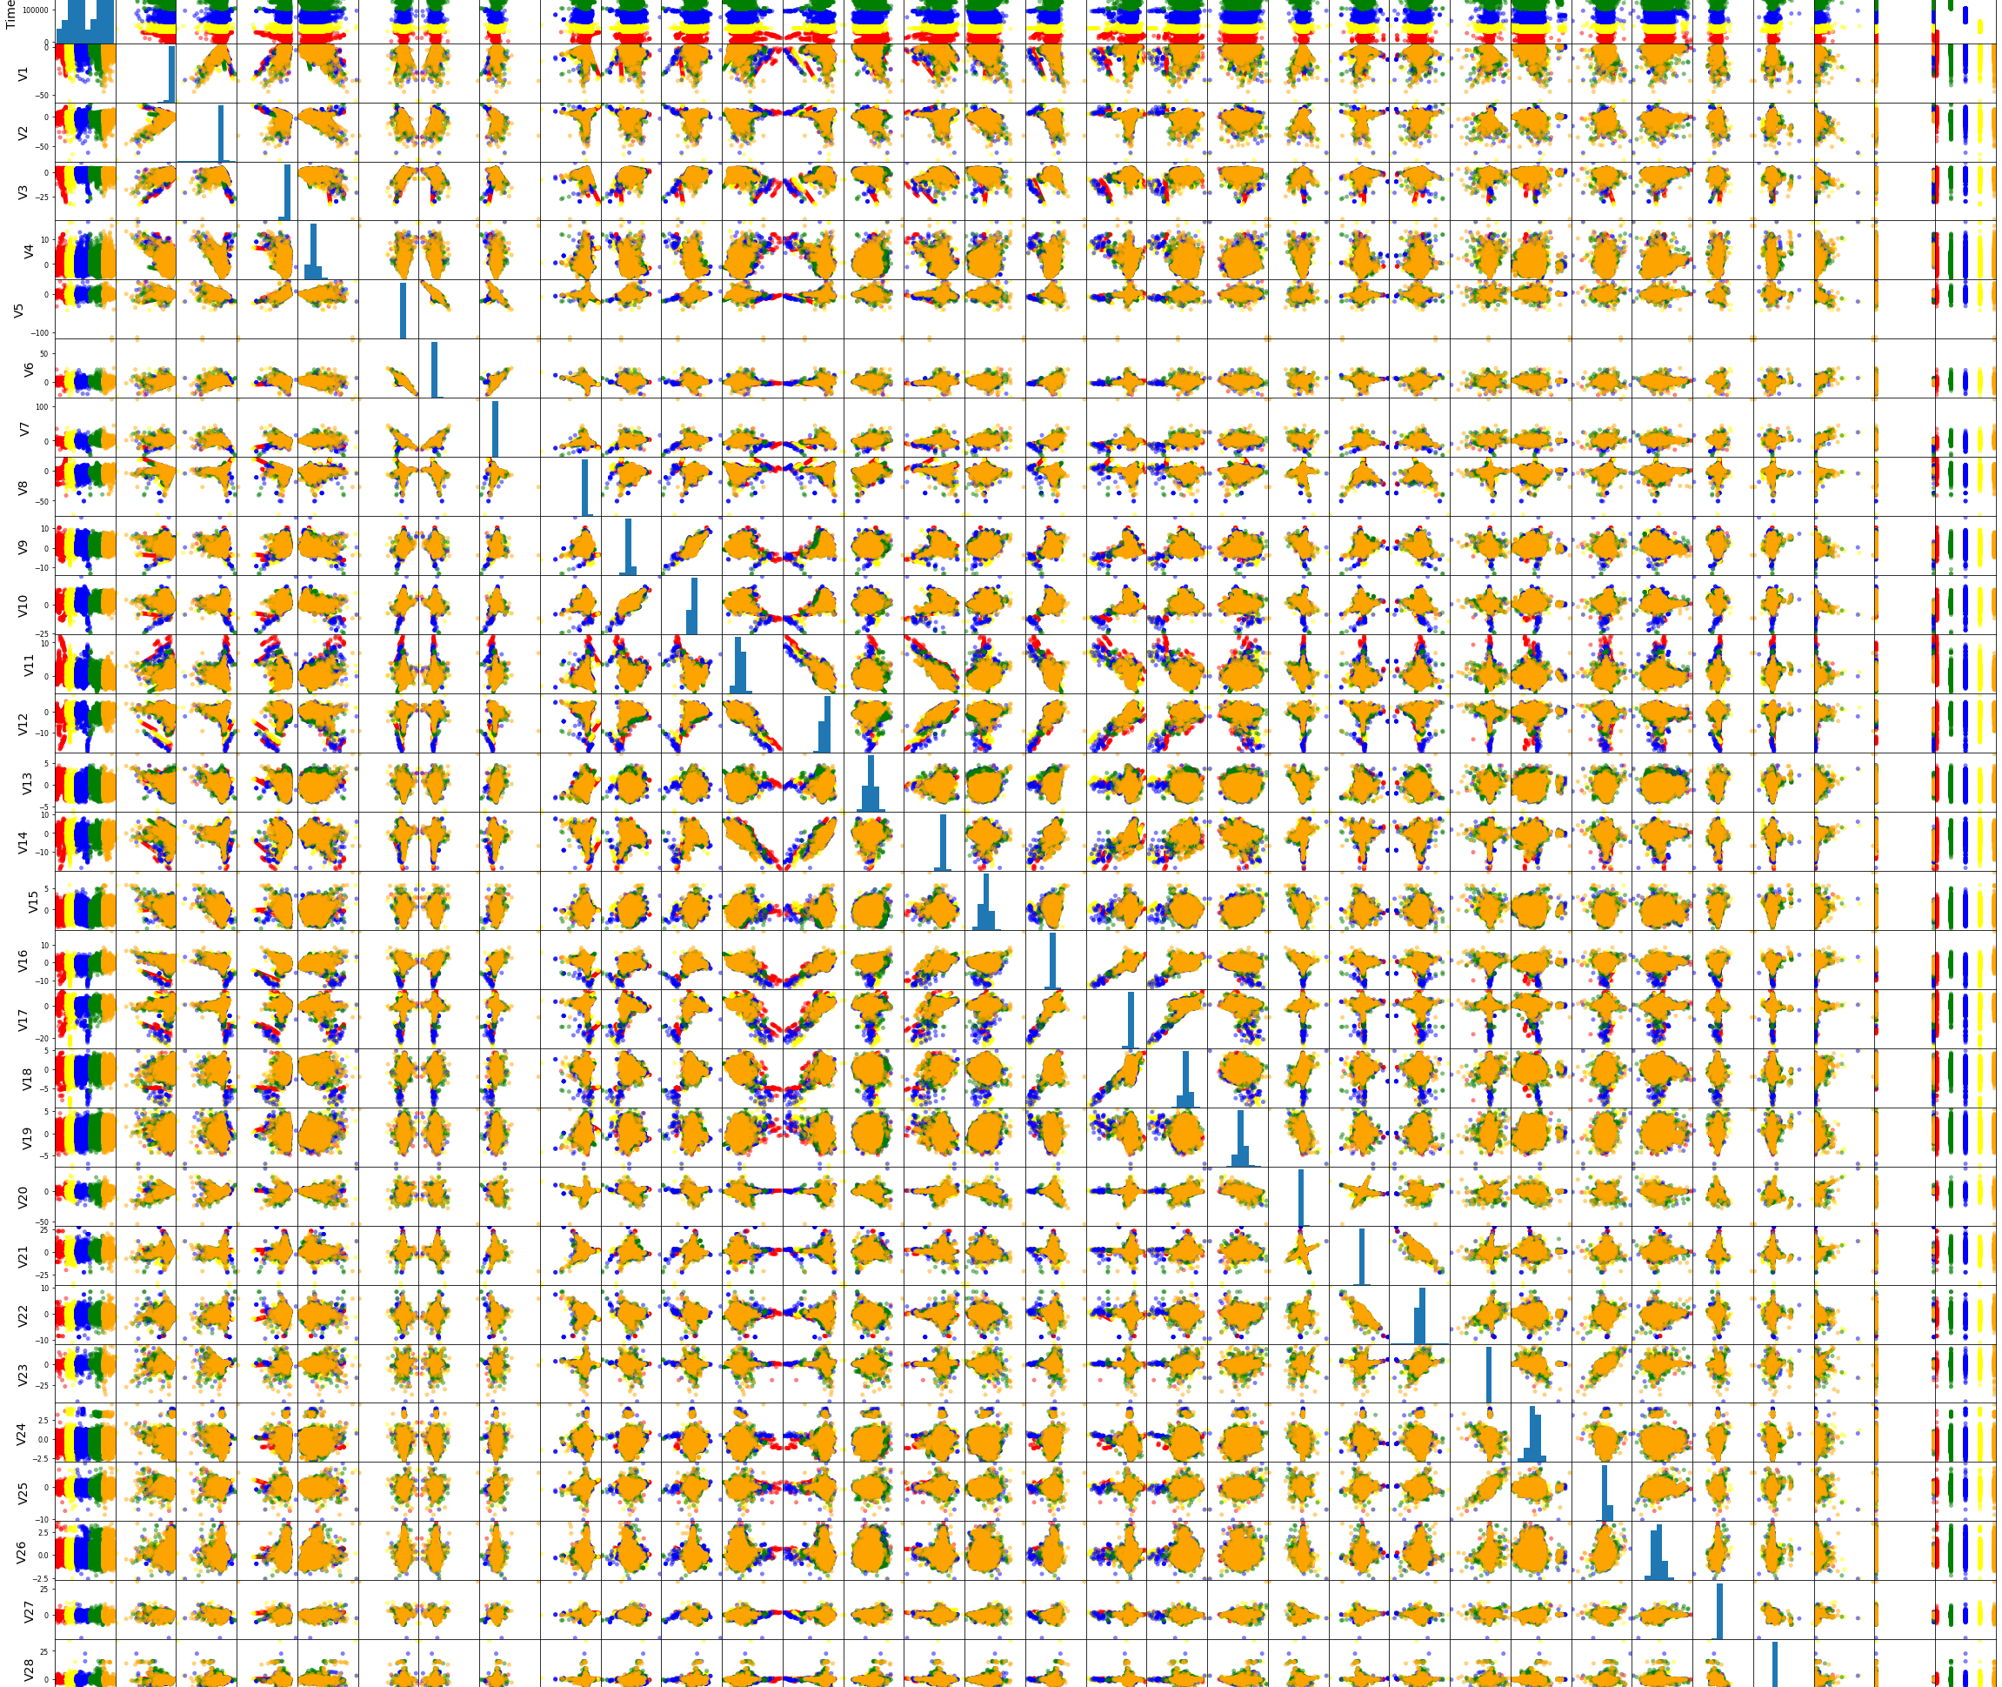
Thanks!

